Slide 1
1 Data and Data Preparation
Business Statistics:
Communicating with Numbers, 4e
By Sanjiv Jaggia and Alison Kelly
Copyright 2022 © McGraw Hill LLC. All rights reserved. No reproduction or distribution without the prior written consent of McGraw Hill LLC.

Slide 2
Chapter 1 Learning Objectives (L Os)
L O 1.1 Explain the various data types.
L O 1.2 Describe variables and types of measurement scales.
L O 1.3 Inspect and explore data.
L O 1.4 Apply data subsetting.

Slide 3
Introductory Case: Retail Customer Data 1
Design a marketing campaign for Organic Food Superstore.
CustID | Sex | Race | BirthDate | … | Channel
1530016 | Female | Black | 12/16/19 86 | … | SM
1531136 | Male | White | 5/9/19 93 | … | TV
… | … | … | … | … | …
1579979 | Male | White | 7/5/19 99 | … | SM
Use the data set to:
Identify Organic Food Superstore’s college-educated millennial customers.
Compare the profiles of female and male college-educated millennial customers.

Slide 4
1.1: Types of Data 1
Data are compilations of facts, figures, or other contents, both numerical and non-numerical.
All types/formats are generated from multiple sources.
Customers/businesses use data from to help make decisions.
Statistics is the language of data.
Statistics is the science that deals with the collection, preparation, analysis, interpretation, and presentation of data.
First: find the right data and prepare it for the analysis.
Second: use the appropriate statistical tool, which depends on the data.
Third: clearly communicate information with actionable business insights.

Slide 5
1.1: Types of Data 2
There are two branches of statistics: descriptive and inferential statistics.
Descriptive statistics refers to the summary of important aspects of a data set.
Includes collecting, organizing, and presenting the data in the form of charts and tables.
Often calculate numerical measures (typical value, variability).
Inferential statistics refers to drawing conclusions about a larger set of data (population) based on a smaller set of data (sample).
A population consists of all items/members of interest.
A sample is a subset of the population.
We rely on sample data to make inferences about various characteristics of the population.

Slide 6
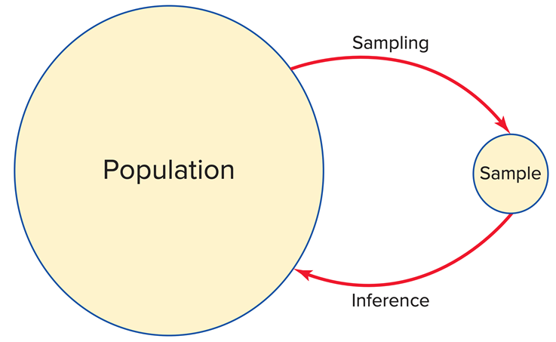
1.1: Types of Data 3
We analyze sample data and calculate a sample statistic to make inferences about the unknown population parameter.
It is generally not feasible to obtain population data.
Obtaining information on the entire population is expensive.
It is impossible to examine every member of the population.
Sample data are generally collected in one of two ways.

Slide 7
1.1: Types of Data 4
Cross-sectional data refers to data collected by recording a characteristic of many subjects at the same point in time, or without regard to differences in time.
Example: 2018-2019 NBA Eastern Conference standings.
Team name | Wins | Losses | Winning percentage
Milwaukee Bucks | 60 | 22 | 0.732
Toronto Raptors* | 58 | 24 | 0.707
Philadephia 76ers | 51 | 31 | 0.622
Boston Celtics | 49 | 33 | 0.598
Indiana Pacers | 48 | 34 | 0.585
Brooklyn Nets | 42 | 40 | 0.512
Orlando Magic | 42 | 40 | 0.512
Detroit Pistons | 41 | 41 | 0.500
*The Toronto Raptors won their first NBA title during the 2018-2019 season.

Slide 8
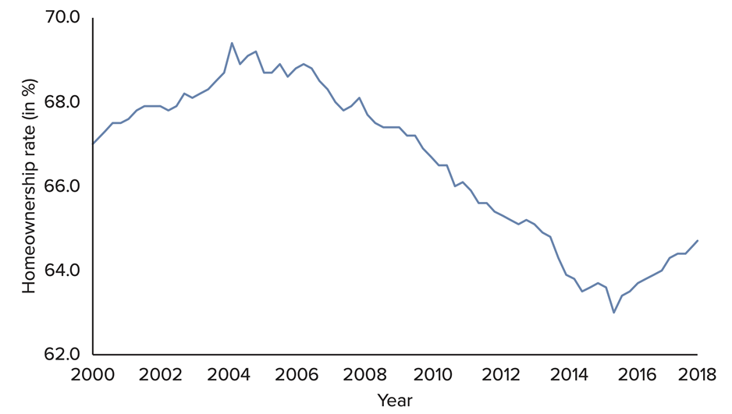
1.1: Types of Data 5
Time series data refers to data collected over several time periods focusing on certain groups of people, specific events, or objects.
Time series data can include hourly, daily, weekly, monthly, quarterly, or annual observations.
Example: homeownership rates (%) in the US.
Access the text alternative for slide images.

Slide 9
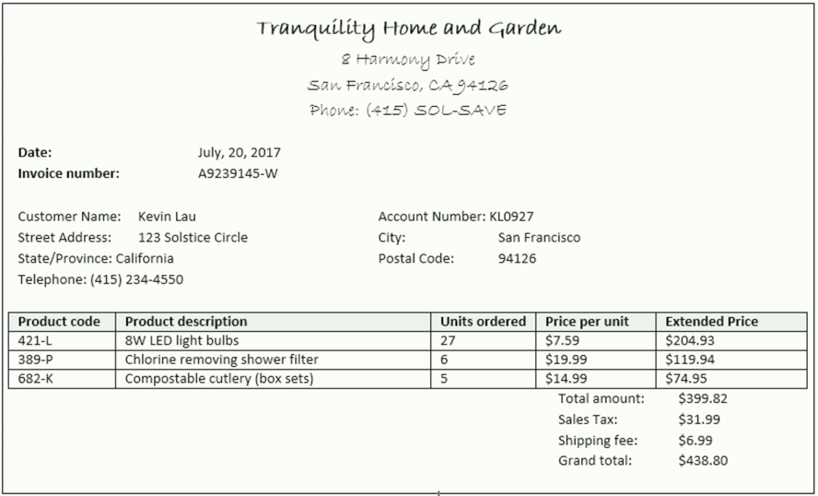
1.1: Types of Data 6
Structured data,
Reside in a pre-defined, row-column format.
Spreadsheet or database applications.
Enter, store, query, and analyze.
Numerical information that is objective and not open to interpretation.
Access the text alternative for slide images.

Slide 10
1.1: Types of Data 7
Today, only about 20% of all data used in business decisions are structured.
Unstructured data.
Do not conform to a pre-defined, row-column format.
Textual and multimedia content.
Do not conform to database structures.
These data may have some implied structure.
Still considered unstructured.
Do not conform to a row-column model required in most database systems.
Example: social media data such as Twitter, YouTube, Facebook, and blogs.

Slide 11
1.1: Types of Data 8
Businesses generate and gather more and more data at an increasing pace: Big Data.
A massive volume of structured and unstructured data.
Extremely difficult to manage, process, and analyze using traditional data processing tools.
Presents great opportunities to gain knowledge and game-changing intelligence.
“[H]igh-volume, high-velocity and/or high-variety information assets that demand cost-effective, innovative forms of information processing that enable enhanced insight, decision making, and process automation” (www.gartner.com).
Does not imply complete (population) data.
Big data may not be used when available.
Inconvenient and computationally burdensome.
Benefits may not justify costs.

Slide 12
1.1: Types of Data 9
There are three characteristics of big data.
Volume: immense amount of data complied for a single or multiple sources.
Velocity: generated at a rapid speed, management is a critical issue.
Variety: all types, forms, granularity, structured or unstructured.
Additional characteristics.
Veracity: credibility and quality of the data, reliability.
Values: methodological plan for formulating questions, curating the right data and unlocking hidden potential.
Having a plethora of data does not guarantee that useful insights or measurable improvements will be generated.

Slide 13
1.1: Types of Data 10
There is an abundance of data on the Internet.
Many experts believe that 90% of the data in the world today was created in the last two years alone.
It is easy to access and find data by using a search engine like Google.
There are several sources of data.
Bureau of Economic Analysis.
Bureau of Labor Statistics.
Federal Research Economic Data.
U.S. Census Bureau.
National Climate Data Center.
Yahoo Finance, Google Finance.
Zillow.
ESPN.

Slide 14
1.2: Variables and Scales of Measurement 1
A variable is a characteristic of interest that differs in kind or degree among various observations (records).
There are two types of variables: categorical and numeric.
Categorical Data.
Also called qualitative.
Represent categories.
Labels or names to identify distinguishing characteristics.
Can be defined by two or more categories.
Coded into numbers for data processing.
Example: marital status, grade in a course.

Slide 15
1.2: Variables and Scales of Measurement 2
For a numerical variable, we use numbers to identify the distinguishing characteristic of each observation.
Numeric Data.
Also called quantitative.
Represent meaningful numbers.
Either discrete or continuous.
A discrete variable assumes a countable number of values.
The values need not be whole numbers.
Example: number of children in a family.

Slide 16
1.2: Variables and Scales of Measurement 3
A continuous variable assumes an uncountable number of values within an interval.
In practice, often measure in discrete values.
Example: weight of a newborn baby.
In order to choose the appropriate techniques for summarizing and analyzing variables, we need to distinguish between the different measurement scales.

Slide 17
1.2: Variables and Scales of Measurement 4
There are four major scales: nominal, ordinal, interval, ratio.
Nominal and ordinal scales are used for categorical variables.
Nominal.
Least sophisticated.
Represent categories or groups.
Values differ by label or name.
Example: marital status.
Ordinal.
Stronger level of measurement.
Categorize and rank data with respect to some characteristic.
Cannot interpret the difference between the ranked values, numbers are arbitrary.
Example: reviews from 1 star (poor) to 5 starts (outstanding).

Slide 18
1.2: Variables and Scales of Measurement 5
Categorical variable are typically expressed in words but are coded into numbers for purposes of data processing.
Typically count the number of observations that fall into each category (or find percentages).
Unable to perform meaningful arithmetic operations.

Slide 19
1.2: Variables and Scales of Measurement 6
Interval and ratio scales are used for numerical variables.
Interval.
Categorize and rank, differences are meaningful.
Zero value is arbitrary and does not reflect absence of characteristic.
Ratios are not meaningful.
Example: temperature.
Ratio.
Strongest level of measurement.
A true zero point, reflects absence of characteristic.
Ratios are meaningful.
Example: profits.
Arithmetic operations are valid on interval- and ratio-scaled variable.

Slide 20
1.2: Variables and Scales of Measurement 7
Example: The owner of a ski resort gathers data on tweens.
Tween | Music Streaming | Food Quality | Closing Time | Own Money Spent ($)
1 | Apple Music | 4 | 5:00 pm | 20
2 | Pandora | 2 | 5:00 pm | 10
… | … | … | … | …
20 | Spotify | 2 | 4:30 pm | 10
Music: nominal.
Food quality: ordinal.
Closing time: interval.
Own money spent: ratio.

Slide 21
1.3: Data Preparation 1
We often spend a considerable amount of time inspecting and preparing the data for the subsequent analysis.
Counting and sorting.
Handling missing values.
Subsetting.
Counting and Sorting.
Among the very first tasks analysts perform.
Gain a better understanding and insights into the data.
Help to verify that the data set is complete or determine if there are missing values.
Sorting allows us to review the range of values for each variable.
Sort based on a single or multiple variables.

Slide 22
1.3: Data Preparation 2
There are two common strategies for dealing with missing values.
The omission strategy recommends that observations with missing values be excluded from subsequent analysis.
The imputation strategy recommends that the missing values be replaced with some reasonable imputed values.
Numeric variables: replace with the average.
Categorical variables: replace with the predominant category.

Slide 23
1.3: Data Preparation 3
Subsetting is the process of extracting a portion of the data set that is relevant for subsequent statistical analysis.
The objective of the analysis is to compare two subsets of the data.
Eliminate observations that contain missing values, low-quality data, or outliers.
Excluding variables that contain redundant information, or variables with excessive amounts of missing values.
We can also subset data based on data ranges.

Slide 24
End of Main Content
Copyright 2022 © McGraw Hill LLC. All rights reserved. No reproduction or distribution without the prior written consent of McGraw Hill LLC.

Slide 25
Accessibility Content: Text Alternatives for Images

Slide 26
1.1: Types of Data 5 – Text Alternative
Return to parent-slide containing images.
The horizontal axis is labeled Year and the vertical axis is labeled Homeownership rate (in %). The horizontal axis ranges from 2000 to 2018 and the vertical axis ranges from 62.0 to 70.0. The graph shows a line curve starting at (67.0, 2000) with a peak at (69.4, 2004). It then falls till (63.5, 2015) and starts rising again from (63.8, 2016). It finally ends at (65.0, 2018). All values are approximated.
Return to parent-slide containing images.

Slide 27
1.1: Types of Data 6 – Text Alternative
Return to parent-slide containing images.
The invoice shows the company name and address and the phone number at the top. The rows Date, Invoice number, Customer name, Street address, State/Province, and Telephone are under the first column and Account Number, City, and Postal Code under the second column. The details of the product ordered are mentioned below it. Product code is in the first column, Product description is in the second column, Units ordered is in the third column, Price per unit is in the fourth column, and Extended Price is in the last column. The total amount showing sales tax and shipping fee is mentioned toward the bottom.
Return to parent-slide containing images.

